Slide 1
CS 211 Computer Architecture Lecture 43: Input Output System – Part 2
Ravi Mittal
ravi.mittal@iitgoa.ac.in
Indian Institute of Technology, Goa

Slide 2
We will study today ..
Last Class
/O Devices: An Introduction
I/O Devices: Architectures
Memory Mapped I/O: Polling
Memory Mapped I/O: Interrupt
Memory Mapped I/O: Direct Memory Access (DMA)
Buses for Interconnection

Slide 3
Acknowledgements
Contents of this presentation has been taken from various sources. Would like to thank original contributors
Book: Computer Systems: A programmer’s perspective, Randal E. Bryant and David R. O’Hallaron
Course 61c, Great Ideas in Computer Architecture, University of California, Berkeley, lecture Input/Output, Prof Asonovic and Prof Katz
Lecture Slides on I/O, course CS 3410, Prof Hakim Weatherspoon, Cornell University
Chapter 7, Input/Output, Computer Organization, William Stallings

Slide 4
The last Class

Slide 5
Five Components of a Computer
Components a computer needs to work
Control
Datapath
Memory
Input
Output
Computer
Processor
Memory
Devices
Control
Input
Datapath
Output
Ref: Krste Asanović & Randy H. Katz, Univ of California, Berkeley

Slide 6
Recall: I/O Bus
How does a program running in CPU interacts with outside world?
Need I/O interface
CPU chip
Register file
ALU
System bus
Memory bus
Main
memory
Bus interface
I/O
bridge
I/O bus
Expansion slots for
other devices such
as network adapters.
USB
controller
Graphics
adapter
Disk
controller
Mouse
Keyboard
Monitor
Disk
Bryant and O’Hallaron, Computer Systems: A Programmer’s Perspective, Third Edition

Slide 7
I/O Device Examples and Speeds
I/O speeds: 8 orders of magnitude between keyboard and graphics
Device | Behavior | Partner | Data Rate (Kb/s)
Keyboard | Input | Human | 0.2
Mouse | Input | Human | 0.4
Microphone | Output | Human | 700.0
Bluetooth | Input or Output | Machine | 20,000.0
Hard disk drive | Storage | Machine | 100,000.0
Wireless network | Input or Output | Machine | 300,000.0
Solid state drive | Storage | Machine | 500,000.0
Wired LAN network | Input or Output | Machine | 1,000,000.0
Graphics display | Output | Human | 3,000,000.0
Notes:
keyboard - 1~30*8 byte per secondhttps://www.quora.com/What-amount-of-data-is-transferred-between-a-mouse-and-a-laptop-when-they%E2%80%99re-connected-via-USB
mouse - ~400 byte per second https://www.howtogeek.com/193866/are-there-any-benefits-from-plugging-your-mouse-into-a-usb-3.0-port/ microphone - 44.1 kHz * 16 bit audio
disks - https://www.storagereview.com/ssd_vs_hdd

Slide 8
Memory Mapped I/O: Polling
Device registers generally serve two functions:
Control Register, says it’s OK to read/write (I/O ready) - Flag
Data Register, contains data
Processor reads from Control Register in loop
Waiting for device to set Ready bit in Control reg (0 → 1)
Indicates “data available” or “ready to accept data”
Processor then loads from (input) or writes to (output) data register
I/O device resets control register bit (1 → 0)
Procedure called “Polling”
Bryant and O’Hallaron, Computer Systems: A Programmer’s Perspective, Third Edition

Slide 9
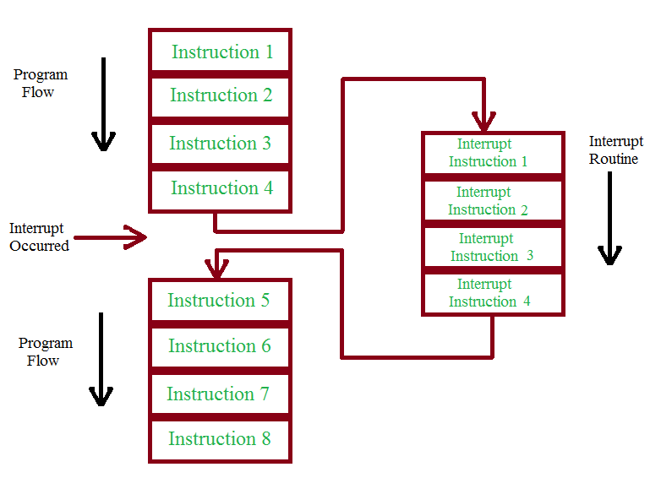
Interrupting the Processor
Interrupt Handler
Ref: CS 61C, Lecture on Input/Output, Branden Ghena, Univ of California, Berkeley

Slide 10
Interrupt-Driven Data Transfer
Memory
(1) I/O
interrupt
add
sub
and
or
user
program
(2) save PC
(3) jump to interrupt
service routine
(5)
read
store
...
jr
interrupt
service
routine
(4) perform transfer
Ref: CS 61C, Lecture on Input/Output, Branden Ghena, Univ of California, Berkeley
Notes:
That is, whenever an I/O device needs attention from the processor, it interrupts the processor from what it is currently doing.
This is how an I/O interrupt looks in the overall scheme of things. The processor is minding its business when one of the I/O device wants its attention and causes an I/O interrupt.
The processor then save the current PC, branch to the address where the interrupt service routine resides, and start executing the interrupt service routine.
When it finishes executing the interrupt service routine, it branches back to the point of the original program where we stop and continue.
The advantage of this approach is efficiency. The user program’s progress is halted only during actual transfer.
The disadvantage is that it require special hardware in the I/O device to generate the interrupt. And on the processor side, we need special hardware to detect the interrupt and then to save the proper states so we can resume after the interrupt.
+2 = 62 min. (Y:42)

Slide 11
Direct Memory Access

Slide 12
Polling and Interrupt: Expensive Operations for Processor
Polling is very expensive – a lot of CPU cycles are consumed
Interrupts remove overhead of polling
But still requires OS to transfer data one word at a time
OK for low bandwidth I/O devices: mice, microphones, etc.
Bad for high bandwidth I/O devices: disks, monitors, etc.
Moving things is a waste of CPU instructions
Instructions are needed to increment memory address and keeping track of how many bytes are moved
Why do you want the CEO to attend the courier person every time?
Ref: CS 61C, Lecture on Input/Output, Branden Ghena, Univ of California, Berkeley

Slide 13
Direct Memory Access (DMA)
Transfer data between I/O and memory without processor control
The CEO may have important letter to send.. It can give it to his/her assistant and get back to work... When the letter is sent, the assistant informs him about it
Transfers entire blocks (e.g., pages, video frames) at a time
Only interrupts processor when done (or if error occurs)
Only interrupts once per page (large!) once transfer is done
Ref: CS 61C, Lecture on Input/Output, Branden Ghena, Univ of California, Berkeley

Slide 14
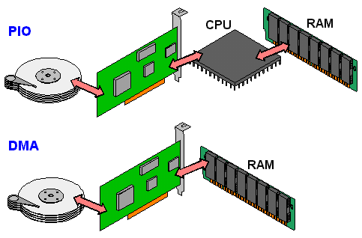


Non-DMA vs. DMA
Non-DMA
Ref: CS 61C, Lecture on Input/Output, Branden Ghena, Univ of California, Berkeley

Slide 15
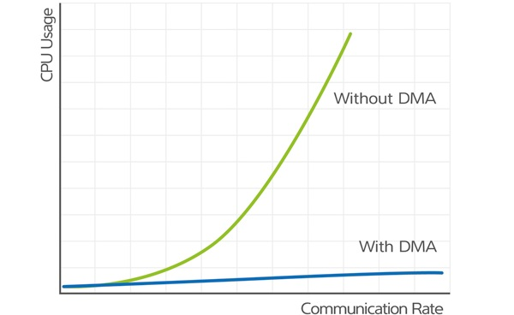
Why do we need DMA?

Slide 16
DMA Controller
CPU tells DMA controller:
Read/Write
Device address
Starting address of memory block for data
Amount of data to be transferred
Direction of transfer
CPU carries on with other work
DMA controller deals with transfer
DMA controller sends interrupt when finished
Ref: CS 61C, Lecture on Input/Output, Branden Ghena, Univ of California, Berkeley

Slide 17
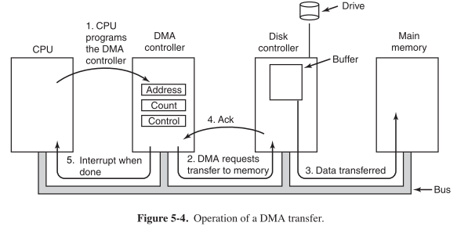
Operation of a DMA Transfer
[From Section 5.1.4 Direct Memory Access in Modern Operating Systems by Andrew S. Tanenbaum, Herbert Bos, 2014]

Slide 18
DMA Controllers
I/O device is attached to DMA controller
Controller itself seen as a memory mapped I/O device
Processor initializes start memory address, transfer size, etc.
DMA controller takes care of bus arbitration and transfer details
CPU ($)
Bus
DMA
DMA
I/O ctrl
Main
Memory
Disk
display
NIC

Slide 19
DMA: Incoming Data (to CPU)
CPU receives interrupt from a device
CPU takes interrupt, begins transfer
Instructs DMA controller/device to place data @ certain address
Device/DMA controller handles the transfer
CPU is free to execute other things
Upon completion, Device/DMA controller interrupt the CPU again
Ref: CS 61C, Lecture on Input/Output, Branden Ghena, Univ of California, Berkeley

Slide 20
DMA: Outgoing Data (From CPU)
CPU decides to initiate transfer, confirms that external device is ready
CPU begins transfer
Instructs DMA controller/device that data is available @ certain address
Device/DMA controller handle the transfer
CPU is free to execute other things
Device/DMA engine interrupt the CPU again to signal the completion
Ref: CS 61C, Lecture on Input/Output, Branden Ghena, Univ of California, Berkeley

Slide 21
Reading a Disk Sector (1)
CPU chip
CPU initiates a disk read by writing a command, logical block number, and destination memory address to a port (address) associated with disk controller.
Register file
ALU
Main
memory
Bus interface
I/O bus
USB
controller
Graphics
adapter
Disk
controller
mouse
keyboard
Monitor
Disk
Bryant and O’Hallaron, Computer Systems: A Programmer’s Perspective, Third Edition

Slide 22
Reading a Disk Sector (2)
CPU chip
Register file
Disk controller reads the sector and performs a direct memory access (DMA) transfer into main memory.
ALU
Main
memory
Bus interface
I/O bus
USB
controller
Graphics
adapter
Disk
controller
Mouse
Keyboard
Monitor
Disk
Bryant and O’Hallaron, Computer Systems: A Programmer’s Perspective, Third Edition

Slide 23
Reading a Disk Sector (3)
CPU chip
When the DMA transfer completes, the disk controller notifies the CPU with an interrupt (i.e., asserts a special “interrupt” pin on the CPU).
Register file
ALU
Main
memory
Bus interface
I/O bus
USB
controller
Graphics
adapter
Disk
controller
Mouse
Keyboard
Monitor
Disk
Bryant and O’Hallaron, Computer Systems: A Programmer’s Perspective, Third Edition

Slide 24
DMA Percent Overhead
Assume the following system properties:
500 clock cycle overhead for each transfer, including interrupt
Disk throughput of 16 MB/s
DMA interrupts after transferring 4 KB (one page)
Processor running at 1 GHz
What percent of the CPU is occupied now?
Freq: 16 [MB/s] / 4 [KB/interrupt] = 4000 [interrupt /s]
Time taken: 4000 interrupt × 500 [clocks] = 2M [clocks/s]
% Time: 2×10⁶ [clocks/s] / 10⁹ [clocks/s] = 0.2%

Slide 25
I/O Processors
A DMA controller is a very simple component
May be as simple as a FSM with some local memory
Some I/O requires complicated sequences of transfers
I/O processor: heavier DMA controller that executes instructions
Can be programmed to do complex transfers
E.g., programmable network card
CPU ($)
Bus
DMA
DMA
IOP
Main
Memory
Disk
display
NIC

Slide 26
Buses for Interconnection

Slide 27
What is a Bus?
There are a number of possible interconnection systems
The most common structure is the bus
A bus connects two or more devices
Often grouped
A number of channels in one bus
e.g. 32 bit data bus is 32 separate single bit channels
Usually broadcast
Everyone listens, must share the medium
Master – can read/write exclusively, only one master
Slave – everyone else. Can monitor data but not produce.
Three types: Data, Address, and Control
data bus
address bus
control bus

Slide 28
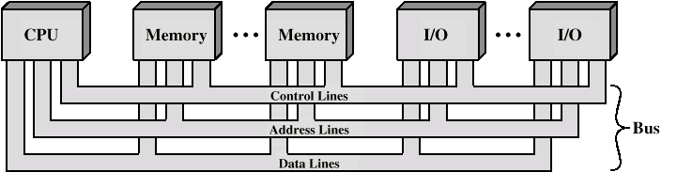
Bus Interconnection Scheme

Slide 29
Bus Types
Data Bus: carries data
Remember that there is no difference between “data” and “instruction” at this level
Width is a key determinant of performance
8, 16, 32, 64 bit
Address Bus: carries address bits
Identify the source or destination of data
In general, the address specifies a specific memory address or a specific I/O port
Control Bus: carries Control and timing information
Determines what modules can use the data and address lines
Typical Control lines: Memory read, Memory write, I/O read, I/O write, Interrupt request, Interrupt ACK, Bus Request, Bus Grant, Clock signals

Slide 30
Bus Parameters
Bus Width: number of wires ; Wider → more bandwidth
Bus Transfer size: data words per bus transaction
Bus Timing:
Synchronous (with a bus clock) or Asynchronous (no bus clock / “self clocking”)
Processor – Memory buses are generally synchronous; Faster
I/O and backplane buses are generally asynchronous
Multiplexed: Address and data share the same lines
Bus Arbitration: Centralized or Distributed

Slide 31
What defines a bus?
Transaction Protocol
Timing and Signaling Specification
Bunch of Wires
Electrical Specification
Physical / Mechanical Characteristics
– the connectors

Slide 32
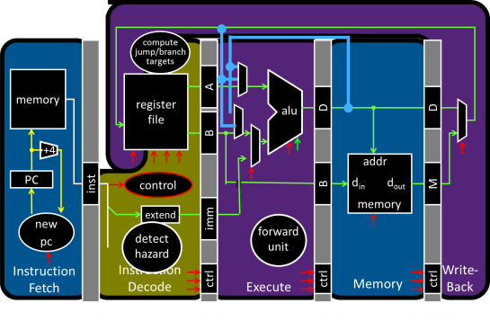
Round 1: All devices on one interconnect
Ref: I/O lecture, Prof Hakim Weatherspoon, Cornell Univ
Unified Memory and I/O Interconnect
Memory
Display
Disk
Keyboard
Network

Slide 33
Single Bus Problems
Lots of devices on one bus leads to:
Propagation delays
Long data paths mean that co-ordination of bus use can adversely affect performance – bus skew, data arrives at slightly different times
Device speed
Bus can’t transmit data faster than the slowest device
Slowest device may determine bus speed!
Consider a high-speed network module and a slow serial port on the same bus; must run at slow serial port speed so it can process data directed for it
Power problems
Most systems use multiple buses to overcome these problems

Slide 34
Round 2: I/O Controllers
Ref: I/O lecture, Prof Hakim Weatherspoon, Cornell Univ
Decouple I/O devices from Interconnect
Enable smarter I/O interfaces – I/O Controller
Core0
Core1
Core0
Core1
Cache
Cache
Cache
Cache
Unified Memory and I/O Interconnect
Memory
Controller
I/O
Controller
I/O
Controller
I/O
Controller
I/O
Controller
Memory
Display
Disk
Keyboard
Network

Slide 35
Round 3: I/O Controllers + Bridge
Separate high-performance processor, memory, display interconnect from lower-performance interconnect
Core0
Core1
Cache
Cache
High Performance
Interconnect
Bridge
Lower Performance
Legacy Interconnect
Memory
Controller
I/O
Controller
I/O
Controller
I/O
Controller
I/O
Controller
Memory
Display
Disk
Keyboard
Network
Ref: I/O lecture, Prof Hakim Weatherspoon, Cornell Univ

Slide 36
Round 4: More Complex Bus Structures
CPU
Graphics
I/O Device #1
I/O Device #2
Caches
DMA
DMA
DMA
I/O Bus Bridge
Fast I/O Bus
Memory Bus
DRAM
DMA
Slow I/O Bus
Slow I/O Bus Bridge
I/O Device #3
I/O Device #4
Match speed of I/O connection to device demands
Special direct connection for graphics
Fast I/O bus for disk drives, Ethernet
Slow I/O bus for keyboard, mouse, touchscreen
Reduces load on fast I/O bus + less bus logic needed on device
Ref: CS 152, Lecture 23 on Input/Output and WSC, , Krste Asonovic Univ of California Berkeley

Slide 37
Round 5: Move from Bus to Crossbar On-Chip
Busses evolved in era where wires were expensive and had to be shared
Crossbar exploits density of on-chip wiring, allows multiple simultaneous transactions
Masters
C
F
A
B
C
B
E
Slaves
D
E
F
A
D
Tristated Bus
Crossbar
Ref: CS 152, Lecture 23 on Input/Output and WSC, , Krste Asonovic Univ of California Berkeley

Slide 38
Interconnect for Modern Systems

Slide 39
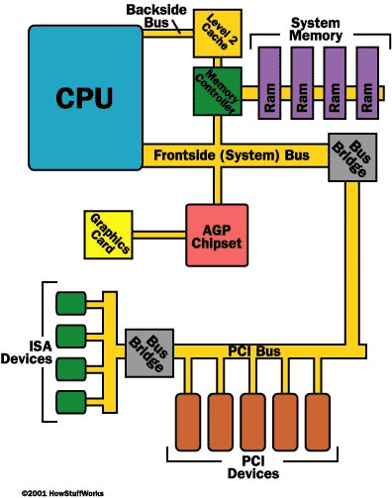
PCI Bus
The PCI Bus was originally 33Mhz and then changed to 66Mhz.
PCI Bus became big with the release of Windows 95 with “Plug and Play” technology
“Plug and Play” utilized the PCI bus concept.

Slide 40
Standard Bus Examples
 | PCI/PCIe | SCSI | USB
Type | Backplane | I/O | I/O
Width | 32–64 bits | 8–32 bits | 1
Multiplexed? | Yes | Yes | Yes
Clocking | 33 (66) MHz | 5 (10) MHz | Asynchronous
Data rate | 133 (266) MB/s | 10 (20) MB/s | 0.2, 1.5, 60 MB/s
Arbitration | Distributed | Distributed | Daisy-chain
Maximum masters | 1024 | 7–31 | 127
Maximum length | 0.5 m | 2.5 m | –
USB (universal serial bus)
Popular for low/moderate bandwidth external peripherals
Packetized interface (like TCP), extremely flexible
Also supplies power to the peripheral

Slide 41
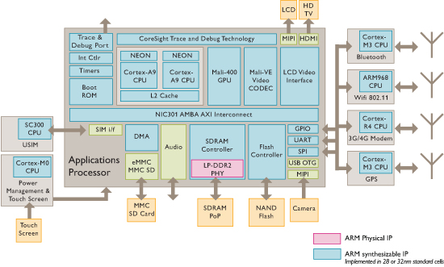
ARM Sample Smartphone Diagram
[©ARM]
Ref: CS 152, Lecture 23 on Input/Output and WSC, , Krste Asonovic Univ of California Berkeley

Slide 42
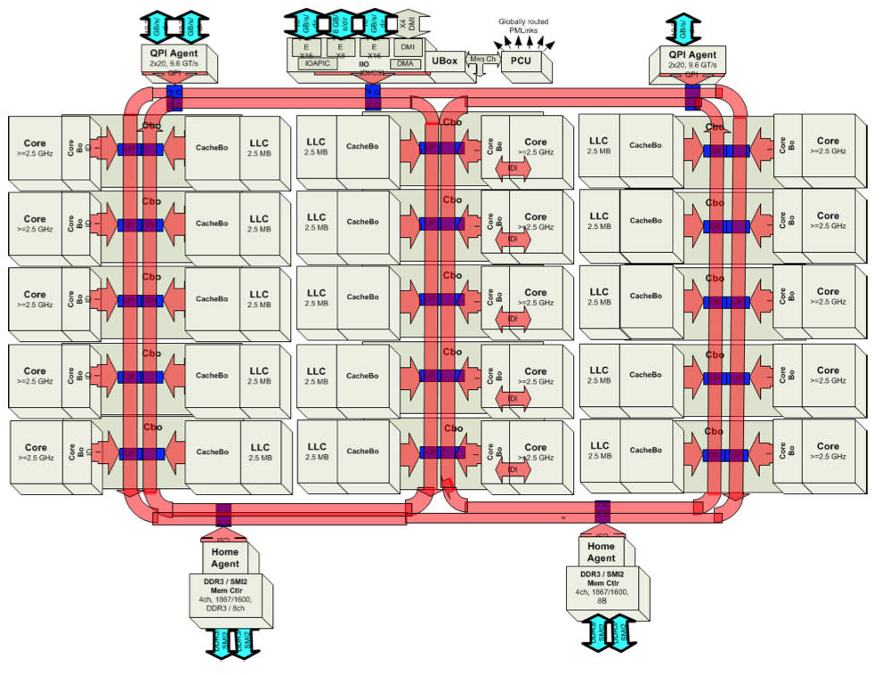
Intel Ivy Bridge Server Chip I/O
[©Intel]
Ref: CS 152, Lecture 23 on Input/Output and WSC, , Krste Asonovic Univ of California Berkeley

Slide 43
Lecture Summary
Direct Memory Access (DMA) saves a lot of time and effort of CPU to manage transfer from I/O devices such as Disk
Buses are used as interconnect between various devices
Single shared bus connecting main memory, Display and multiple I/O devices such as Disk, Mouse, Printer
Has many bottlenecks
Hence, it is good to separate out I/O bus from fast system and Memory bus

Slide 44
Backup Slides

Slide 45
Synchronous Bus
Includes a clock in the control lines – bus includes a clock line
A bus clock signal provides timing information for all actions
All devices can read clock line
Changes occur relative to the falling or rising edge of the clock
A fixed protocol for communication that is relative to the clock
Advantage: involves very little logic and can run very fast, easier to implement
Disadvantages:
Every device on the bus must run at the same clock rate
To avoid clock skew, they cannot be long if they are fast
Notes:
There are substantial differences between the design requirements for the I/O buses and processor-memory buses and the backplane buses.
Consequently, there are two different schemes for communication on the bus: synchronous and asynchronous.
Synchronous bus includes a clock in the control lines and a fixed protocol for communication that is relative to the clock.
Since the protocol is fixed and everything happens with respect to the clock, it involves very logic and can run very fast. Most processor-memory buses fall into this category.
Synchronous buses have two major disadvantages: (1) every device on the bus must run at the same clock rate. (2) And if they are fast, they must be short to avoid clock skew problem.
By definition, an asynchronous bus is not clocked so it can accommodate a wide range of devices at different clock rates and can be lengthened without worrying about clock skew.
The draw back is that it can be slow and more complex because a handshaking protocol is needed to coordinate the transmission of data between the sender and receiver.
+2 = 28 min. (Y:08)

Slide 46
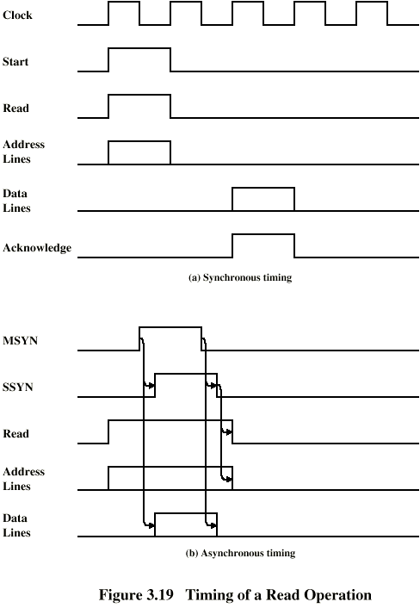
Synchronous Timing Diagram Read Operation Timing
Indicates read/address lines valid, noticed by memory
Indicates we want to read, not write
Address from memory we want
delay
Data from memory
Indicates data lines valid
Notes:
Timing of a Read Operation

Slide 47
Synchronous - Disadvantages
Although synchronous clocks are simple, there are some disadvantages
Everything done in multiples of clock, so something finishing in 3.1 cycles takes 4 cycles
With a mixture of fast and slow devices, we have to wait for the slowest device
Faster devices can’t run at their capacity, all devices are tied to a fixed clock rate
Consider memory device speed faster than 10ns, no speedup increase for 100Mhz clock
One solution: Use asynchronous bus

Slide 48
Asynchronous Bus
It is not clocked - No clock signal to synchronize actions
Occurrence of one event on the bus follows and depends on a previous event
Requires tracking of state, hard to debug, but potential for higher performance
Operates in master-slave mode
Uses handshaking to perform a bus transaction
It can accommodate a wide range of devices
It can be lengthened without worrying about clock skew
It requires a handshaking protocol
Also used with networking
Problem with “drift” and loss of synchronization
Some use self-clocking codes, e.g. Ethernet
Notes:
There are substantial differences between the design requirements for the I/O buses and processor-memory buses and the backplane buses.
Consequently, there are two different schemes for communication on the bus: synchronous and asynchronous.
Synchronous bus includes a clock in the control lines and a fixed protocol for communication that is relative to the clock.
Since the protocol is fixed and everything happens with respect to the clock, it involves very logic and can run very fast. Most processor-memory buses fall into this category.
Synchronous buses have two major disadvantages: (1) every device on the bus must run at the same clock rate. (2) And if they are fast, they must be short to avoid clock skew problem.
By definition, an asynchronous bus is not clocked so it can accommodate a wide range of devices at different clock rates and can be lengthened without worrying about clock skew.
The draw back is that it can be slow and more complex because a handshaking protocol is needed to coordinate the transmission of data between the sender and receiver.
+2 = 28 min. (Y:08)

Slide 49
Asynchronous Timing Diagram
Asserted once read/address lines stabilize
Deasserted when finished reading
Master sync
Slave = memory, ACK’s master sync
Master reads the data from the data bus
Slave sync
Slave places requested data on bus

Slide 50
Connecting I/O Devices with I/O Bus
I/O Bus connects I/O device: Graphics card, Monitors, mice, keyboards, Disks with the CPU and Main Memory
I/O Buses are designed to be independent of CPU
Note that system bus and memory bus are based on CPU
I/O bus is slower than System Bus and Memory Bus
I/O bus can accommodate a wide variety of third-party I/O devices
USB Controller
Graphics Adapter
Host bus Adapter
Network Adapters

Slide 51
USB Controller and Graphics Adapter
USB Controller is a conduit for devices attached to a USB Bus
USB: Widely popular standard for connecting a wide variety of peripheral I/O Devices including
Keyboards, mice, modems, digital cameras, game controllers, printers, external disk drives, solid state disks
USB 3.0 buses have a maximum bandwidth of 625 MB/s
USB 3.1 buses have a maximum bandwidth of 1,250 MB/s
A graphics card (or adapter) contains hardware and software logic that is responsible for painting the pixels on the display monitor on behalf of the CPU.

Slide 52
Bus Arbitration: Bus Arbitration
Bus master: component that can initiate a bus request
Bus typically has several masters, including processor
I/O devices can also be masters (Why? See in a bit)
Arbitration: choosing a master among multiple requests
Try to implement priority and fairness (no device “starves”)
Daisy-chain: devices connect to bus in priority order
High-priority devices intercept/deny requests by low-priority ones
Simple, but slow and can’t ensure fairness
Centralized: special arbiter chip collects requests, decides
Ensures fairness, but arbiter chip may itself become bottleneck
Distributed: everyone sees all requests simultaneously
Back off and retry if not the highest priority request
No bottlenecks and fair, but needs a lot of control lines

